Slide 1
Lecture 1: Complexity and Software Product Lines
Gregory Gay
(Portions of the slides by Thorsten Berger)
TDA 594/DIT 593 - November 1, 2022

Slide 2
In the beginning...

Slide 3
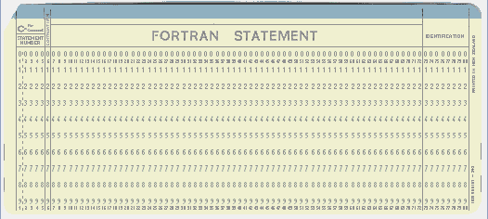
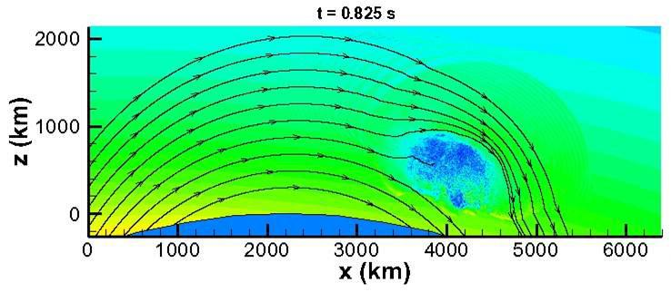
Software Was Small
Both physically…
And in scope.
Notes:
In the beginning, software was small. This was true physically - code small enough to fit on punch cards, computing power was limited, so we can’t run much. By necessity and because of lack of experience, in scope too. Important - very important - but focused on particular problems. Missile trajectories, Simulations, wargames, code breaking. Single task - no API or code reuse, limited functionality

Slide 4
Software Starts to Grow Up
Languages like C introduce file linking.
Enables organization of code and reuse of code.
SIMULA-67, Smalltalk introduce objects.
Enables organization of code into focused units that work with other objects to perform larger tasks.
Sections of the code “activate” when needed.
We can group together related functionality, ignore unrelated functionality, and find what we need when making changes.
Code can be reused in future projects.
Notes:
Then, however, our experience and computing power grew and matured, and we started to expand our ideas of what could be done with software.

Slide 5
Fast forward to the present day...

Slide 6

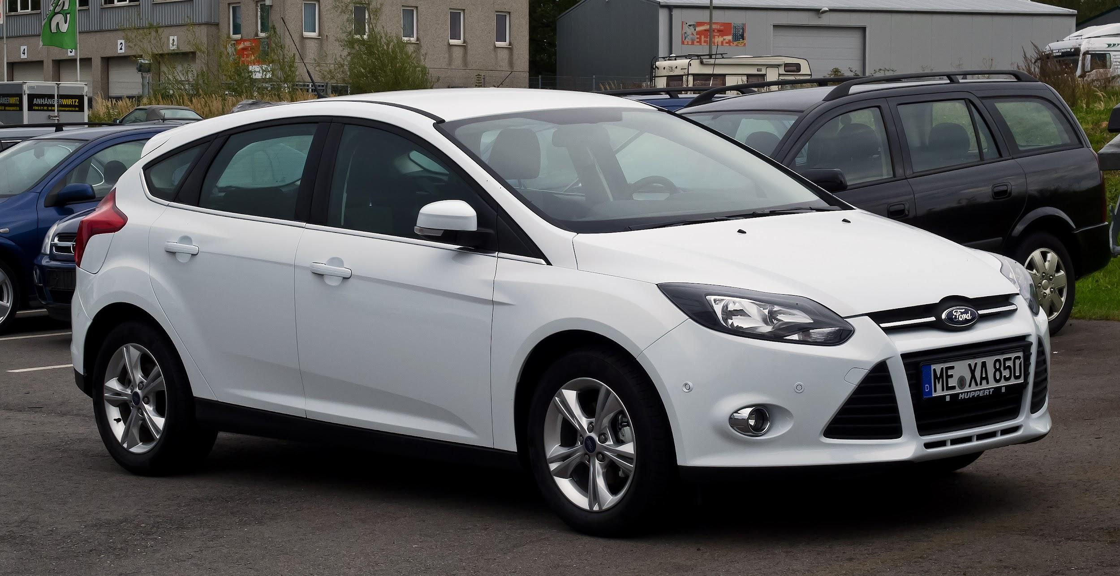

Our Society Depends on Software
This is software: So is this:
Also, this:
Notes:
The scope has expanded.
A webpage, of course, is powered by software. No one disputes that. If I ask you about software, you’d mention something like this - a web app, a video game, a word processor. That’s not all that is software though - Our society is built on software. It powers our homes, it manages our private information, it controls our cars, it automates our factories and it even regulates our bodies. Real-world software systems are becoming increasingly complex and pervasive. Consider application domains such as enterprise computing (e.g., data-processing/AI systems), business information systems (e.g., web portals), cyber-physical systems (e.g., automotive software, home automation), systems software (e.g., operating system kernels), or mobile software and software ecosystems (e.g., Android OS and its apps).

Slide 7
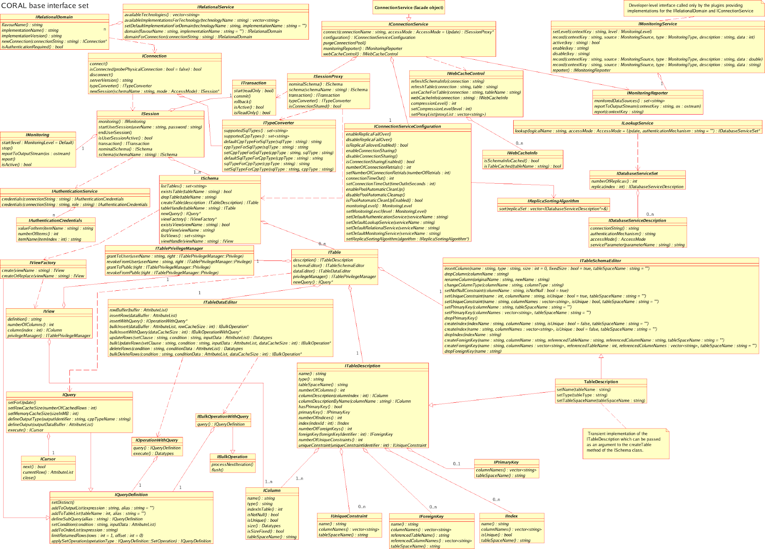
Under the Hood
Systems have millions of lines of code.
In hundreds of classes.
We want to reuse code.
On different hardware.
In many different apps.
We want the systems to live for years.
Notes:
All of these domains boast software systems of unprecedented complexity, many of which are long-living and exist in many different variants. However, growth in scope means growth in the size and complexity of the code base. (1-2). If not more - it came out last year that Facebook’s iOS app had 18000 classes. Now, this is a bit more than usual, and partially the result of automated code generation. However - hundreds is common. Keeps growing. (3) and extend that code, we want to run it on many different hardware platforms and in many different apps, or different version of the same app, with only minor adaptations. We want these systems to last for years to come and be flexible and customizable for new situations or types of users.

Slide 8
Growing Pains
Hard to understand complex systems.
Hard to find the code you need.
Hard to plan for new hardware, new variants, ...
Results in chaos.
Only 16.1% of projects delivered on time.
31.1% cancelled before delivery.
Delivered projects may be flawed.
Notes:
Ultimately, this growth is good - we can do incredible things with software that were impossible before. But it comes at a cost, and there are some growing pains. No person can understand an entire million-line codebase.Classes organize code, but how can you find the right clases when there are thousands? It’s hard to plan for all circumstances, like new pieces of hardware, or new interfaces, new access methods, new variants of your codebase. This (4)
Only 16.1% of projects delivered on time and within budget, with all planned features complete as specified. 31.1% of projects are cancelled before delivery. Delivered projects may be slow, insecure, missing features, have duplicate code, go down often, et

Slide 9
Designing Modern Software
The key to delivering robust software?
Designing an understandable, organized system.
Verifying that features of the system interact correctly.
AKA: “taming the complexity”
This course is about taming complexity.
Exemplified primarily through software product lines.
Notes:
So, the key to delivering robust software is through a thorough design and verification process (2-4). This course is about taming that complexity. (last point), highly configurable families of systems built around commons, modularized features. Dedicated planning, modeling, design, realization, and advanced analysis are needed to deliver these systems in a safe, robust, and secure manner.

Slide 10
Today’s Goals
Introduce TDA 594/DIT 593 - Software Engineering Principles for Complex Systems
AKA: What the heck is going on?
Go over syllabus
Clarify course expectations
Assignments/grading
Answer any questions
Discuss software complexity
Introduce the concept of software product lines

Slide 11
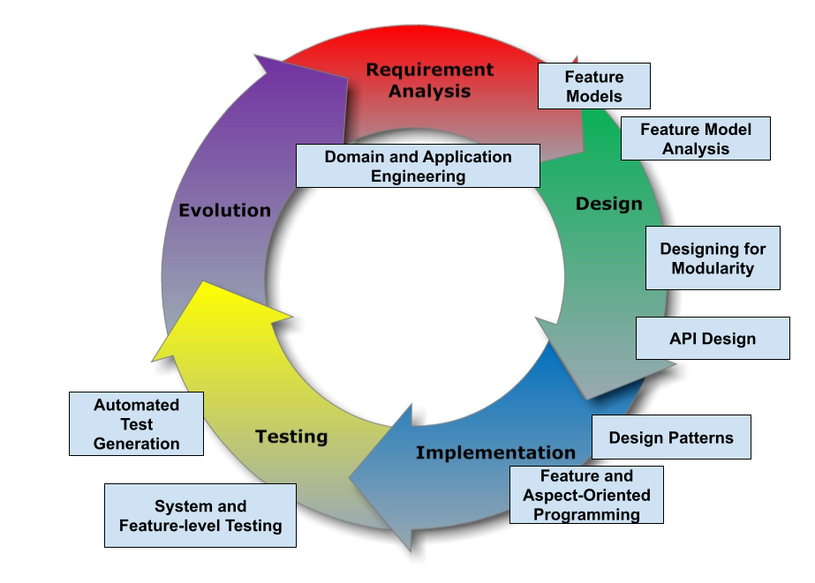
TDA/DIT 594 - SE Principles for Complex Systems
Notes:
The goal of this course is to present advanced techniques aimed at creating complex systems with many interacting features and variable configurations. We will examine the design, implementation, and verification of complex systems, focusing on managing complexity at different stages of the system development life cycle. We will also examine how the development process must be organized to deliver such systems. (go over core topics)

Slide 12
Complex???????????
Variability
The ability to change and customize software to deliver variants to new users.
Requires designing code to be reused and to work with reused code.
Changeability and Maintainability
The ability to add new features and options while ensuring that existing code still works.
Notes:
Now, what the $#%#^#$ does complex mean? “complex” can describe about anything. Almost any piece of software you will build, ever, in a professional setting is going to be complex. Anything you build in a team. Anything that is sold commercially. Arguably, every single class you’ve taken here has been prep for building complex systemn. So, we need to focus in this class in some way. Our focus is, then, on variability and evolution. Variability is the ability to change and customize software, to choose from a set of options to configure and evolve software to the needs of new groups of users users over time, delivering these customized variants to the users that need them. Variability is not a one and done design choice - it is a concious process of designing for evolution. It requires designing and redesigning systems to be reused and to work with the code you are reusing. It requires a constant focus on changeability and maintainability. Our ability to add new options and features to code over time, and our ability to keep the existing code still working in the face of constant change. In this class, that is what we define complex to mean and what we focus on.

Slide 13
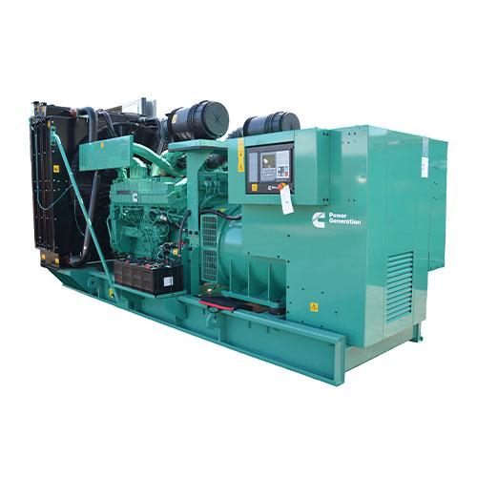
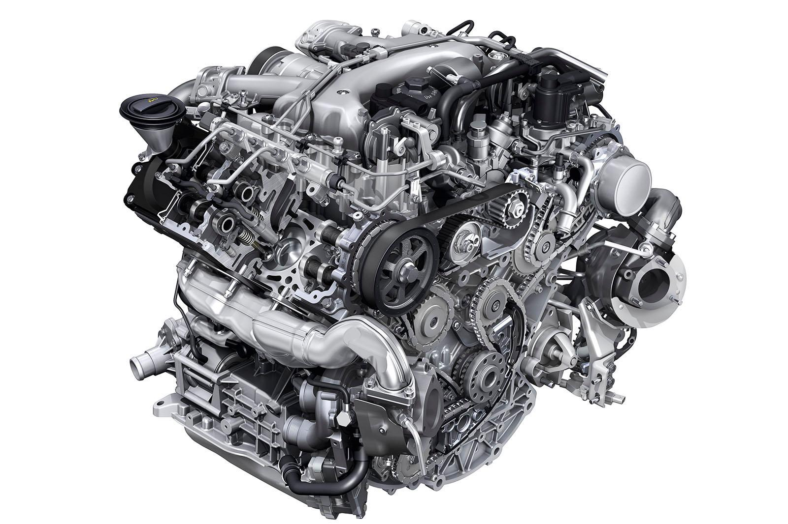
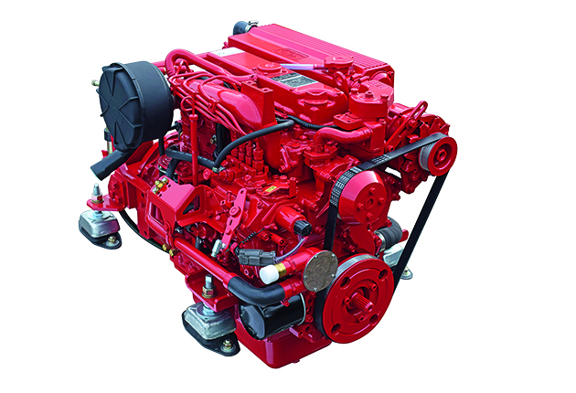
Software Product Lines (SPLs)
Highly configurable families of systems.
Built around common, modularized features.
Common set of core assets.
Allows efficient development, customization.
Core Platform
Notes:
Much of this course will focus on software product lines (SPLs). A SPL is a highly configurable system built as a platform containing common, modularized features. This enables easy customization and adaptation for new clients or changing market conditions. Customized versions of the system are developed from a common set of core assets in a planned way. By developing large software systems in this way, companies can produce a set of products more economically, since the development effort put into the shared assets does not need to be duplicated. SPLs can also help companies to better address product customization tasks to meet specific needs of individual customers. This allows sustaining a high rate of product innovation, while keeping guaranteed levels of overall system performance and quality.

Slide 14







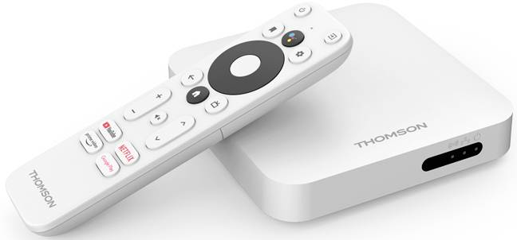

Software Product Lines (SPLs)
Core Platform
Core Platform
event handling
Notes:
We will talk much more about these, but to give two examples: the Android OS provides a set of core libraries and components that can be tuned by phone manufacturers to particular devices. A Samsung Galaxy S10 and the new Motorola RAZR look nothing alike - have different hardware, different user interfaces, but are largely powered by the same software underneath the surface, customized to its particular operating circumstances. It’s not just hardware, though, but the behavior of Android OS can be customized based on the apps installed. Different apps can handle events, like sharing, by implementing common interfaces. The options when I share something from my phone may differ from the options when you do so.
A second comes from Cummins, the world’s largest manufacturer of diesel engines - their core software covers 9 basic engine types ranging over 4-18 cylinders and 4-164 liters of displacement, with 12 kinds of electronic control modules, 5 kinds of processors, and 10 kinds of fuel systems. The core software - 20 basic software builds - have been deployed into over 1000 separate products. These stories are common, and we will also dive into SPLE at Volvo or Boeing, in Linux, and in many other circumstances. We will also examine other forms of complex systems and provide insight into how they are delivered.

Slide 15
Why Software Product Lines?
Designed FOR reuse of assets.
Designed TO reuse assets.
Successful SPLs are highly configurable, and evolve easily over time.
Most modern systems intend to achieve at least one of these two tasks.
SPLs achieve both.
Notes:
Why focus on SPLs? Because they are hugely complex systems that are both designed (1) - we build independent, modularized components that can be selectively integrated. they are also designed (2) - build with a highly evolvable architecture that can easily slot in components. This combination is potent because (3). They are hard to get right, but if you nail it, you NAIL it. Reuse is the name of the game now, regardless of what kind of system you build. The reality of modern software is that most modern systems are designed to achieve at least one of these tasks - they are designed to be reused in some form or to make use of reused assets. If you use a third party code library, you are reusing assets. If you build a standalone, single-purpose system with a REST API, you have designed a system FOR reuse. If you build an Android app that can be launched by another app to respond to a system event, you’ve built a component FOR reuse. Most modern software is designed either to be reused to to reuse assets. SPLs are designed for both. By examining SPLs in detail, we can teach design and verification techniques that apply to a wide range of complex systems, even if they are not SPLs themselves. Design techniques for SPLs are design techniques for any evolvable reuse-driven system.

Slide 16
Teaching Team
Examiner
Greg Gay (ggay@chalmers.se) (Course Responsible)
Co-Teacher
Daniel Strüber (danstru@chalmers.se)
Supervisors
Kevin Ayad (gusayake@student.gu.se)
Ricardo Caldas (ricardo.caldas@chalmers.se)
Malik Hannan (gusmalikah@student.gu.se)
Wardah Mahmood (wardah@chalmers.se)
Mazen Mohamad (mazenm@chalmers.se)
Notes:
I’m front-line, examiner, course responsible, and the one you will see most often in the classroom. However, many lectures will also be taught by my co-teacher Daniel Struber. Your group projects will be supervised by these students (go over).

Slide 17
Feedback! Questions!
Ask questions in Canvas discussion forum.
If private, contact teachers (about lectures), supervisors (assignments).
If highly sensitive, contact me (Greg Gay)
Course feedback should be sent to student representatives.
Send feedback early and often!
Notes:
We understand that it can be difficult to get answers to your questions. We recommend the following methods for contacting the teaching staff.
Any questions related to the lectures or assignments can be asked in the Canvas discussion forum. This forum will be monitored by the teachers and supervisors. You may also e-mail your supervisors directly about assignments and the teachers about lecture content. However, we recommend posting questions to the forum to help other students who may be having similar issues.
Private or otherwise sensitive questions may be sent to the supervisors or teachers directly. You are welcome to e-mail Greg Gay (course responsible) directly if the topic is of a highly sensitive nature.
Course feedback should be presented to the student representatives, who will pass it on to the teachers. Please offer feedback to the student representatives first. However, if you have any issues that are time-sensitive or private, you may contact Greg Gay directly. We welcome course feedback, and are happy to adjust the course to correct issues affecting a majority of the students. I’m new. I’m going to make mistakes. I’ll forget things, try things that don’t work out, and will change things as we go along. Don’t hesitate to contact us at any time. I want your feedback. If something isn’t working, don’t wait until the end to tell me - let me know and we’ll see what we can do about it.

Slide 18
Course Content
https://chalmers.instructure.com/courses/20944
All lectures, files, reading goes here.
Pay attention to the schedule/announcements.
https://greg4cr.github.io/courses/fall22tda594/
Backup of Canvas page/course materials.
Likely out of date, but may work if Canvas isn’t working.
Notes:
Course content will live in Canvas

Slide 19
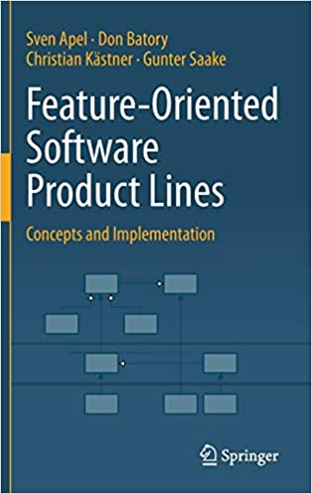
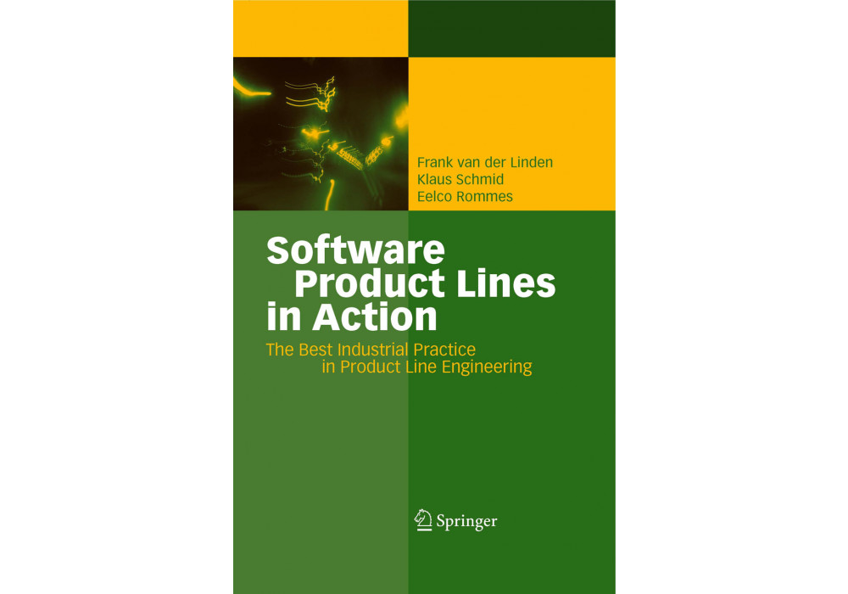
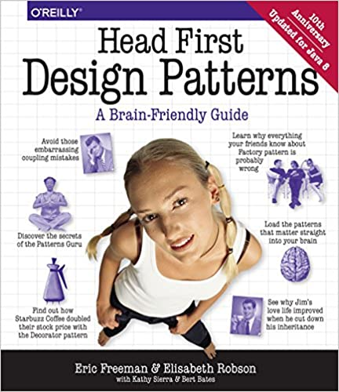

Course Literature
Apel, S., Batory, D., Kästner, C., & Saake, G. Feature-oriented software product lines.
Van der Linden, F. J., Schmid, K., & Rommes, E. Software product lines in action: the best industrial practice in product line engineering.
Freeman E, Robson E., Bates B., & Sierra, K. Head First Design Patterns.
Free via Chalmers library.
Pezze M., Young M. Software Testing and Analysis: Process, Principles, and Techniques
Free via https://ix.cs.uoregon.edu/~michal/book/free.php
Additional literature will be provided via Canvas.
Notes:
There is no mandatory course literature. Many materials have been used in the creation of slides and assignments. The following optional textbooks were used to prepare lecture slides:
Apel, S., Batory, D., Kästner, C., & Saake, G.. Feature-oriented software product lines. (available online via SpringerLink, use a Chalmers IP address to get it for free).
Van der Linden, F. J., Schmid, K., & Rommes, E.. Software product lines in action: the best industrial practice in product line engineering. (available online via SpringerLink, use a Chalmers IP address to get it for free).
Freeman, E., Robson, E., Bates, B., & Sierra, K.. Head First Design Patterns. (available online via https://www.vlereader.com/Reader?ean=9780596800741 (Links to an external site.), use a Chalmers IP address to get it for free)
Pezze, M., Young, M. Software Testing and Analysis: Process, Principles, and Techniques. (available for free from https://ix.cs.uoregon.edu/~michal/book/free.php (Links to an external site.))
These books were referenced during the creation of some of the slides, and provide theoretical material relevant to many of the course concepts. In cases where the books are older, we make use of theoretical content that is still relevant to modern systems, while discarding outdated theory and updating technological concepts. Students are recommended to obtain a free copy for use when studying the material in the course.
Additional optional literature will be provided for individual topics.

Slide 20
Course Design
Language of Instruction: English
Lectures
Tuesday and Thursday, 13:15 - 15:00.
Attendance is highly recommended.
Supervision
Once per week, mandatory attendance.
Notes:
In case you hadn’t noticed, (1). Jag pratar bara lite svenska, so we’re going to work in English. Trust me, you’ll be happier that way than if I try to do this in Swedish. The teaching consists of lectures, individual assignments, group assignments, as well as supervision in connection to the assignments. The course emphasizes problem-based learning. Basic concepts are presented in the lecture, applied in in-class exercises, and then extended in the context of integrated, graded assignments. A series of group assignments are developed in teams of students. There are also two individual assignments designed to assess critical thinking about the course content.
There will generally be two lectures per week (Tuesday and Thursday, 13:15 - 15:00). Attendance in lectures is highly recommended, but not mandatory. As the assignments will correspond to material taught in the lectures, it is recommended that you attend the lectures. Note that any material covered in lectures can be referred to in individual or group assignments (i.e., not just material written in the slides). Supervision: Formal supervision sessions will be held weekly with your assigned supervisor. These sessions give students the chance to apply class concepts, as well as to see demonstrations. Supervisors will be present to answer questions, as will (at times) the teachers. Attendance in supervision sessions is mandatory. Your assigned supervisor will work with you to schedule a time slot.

Slide 21

Examination Form
Group Project
6.0 Credits, Scale: 3-5 and Fail (U)
Four assignments
Groups of six students
Correspond to topics covered in the lectures
Case Studies, Domain Analysis, Modeling, Implementation, Testing
Notes:
The course is examined by individual written assignments and a project (a series of semi-linked assignments) normally carried out in groups of 6 students.
The project part is examined on the basis of solutions to compulsory problems handed in during the course and on the basis of individual contribution to the group work. Each student will be responsible for contributing to each assignment. The project will consist of approximately 4 group assignments. Each assignment is equally weighted. Specific requirements for the assignments will be provided on Canvas. The assignments will correspond to the order of topics in the lectures, covering case studies, domain analysis, modeling, implementation, and testing of complex SPLs. Students are required to complete written self- and peer-assessment forms during the course which will be part of the assessment of the student's individual contribution to the project. The instructor may adjust the individual grades of a student depending on this evaluation.

Slide 22
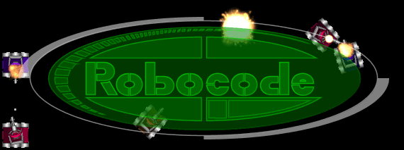
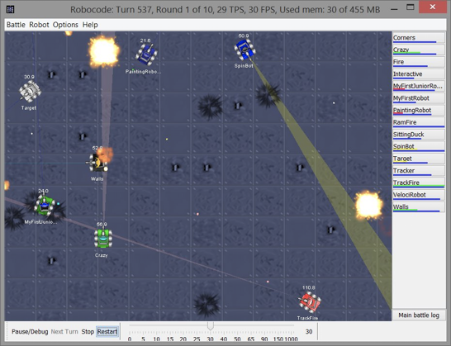
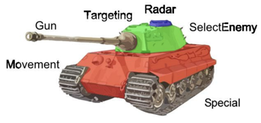
For information about Robocode, see https://robocode.sourceforge.io/ and the RoboWiki (https://robowiki.net/wiki/Main_Page).
Notes:
To give a common SPL platform, we will focus several of the group assignments on Robocode. Robocode is a programming game, where the goal is to develop a robot battle tank to battle against other tanks in Java or .NET. The robot battles are running in real-time and on-screen. A focus in the project will be on re-engineering variants of Robocode bots, which are highly interesting systems, covering different architectural styles and levels of intelligence (for instance, incorporating AI to learn the best strategy to succeed in the Robocode simulator).
For information about Robocode, see its home page (https://robocode.sourceforge.io/) and the RoboWiki (https://robowiki.net/wiki/Main_Page).

Slide 23
Forming Groups (Assignment 0)
You may choose your groups.
6 people
Submit one e-mail per group to ggay@chalmers.se
Names of all members. I will reply with a group number.
Indicate in Canvas submission either team number or if you want to be assigned to a team.
Due Thursday, November 3, 11:59 PM
Notes:
more details on Canvas

Slide 24
Examination Form
Individual Assignment
1.5 credits, Grading scale: 3-5 and Fail (U)
One assignment, at end of course.
Will assess critical understanding.
All assignments must be submitted.
Final grade in group project is average of assignment grades.
Rubrics provided for each assignment.
Notes:
The written assignment portion of the course will consist of one individual written assignments, with open-ended questions designed to assess the student’s understanding of the core topics of the course. These will be due at approximately the end of the course, and will closely correspond to the lecture content presented up to that point. More on that soon.
The two sub-courses (written assignments and project) are graded individually, both of which comprising the grading scale: 3, 4, 5, and Fail (U). If you get a 3 in both, you get a 3 in the class. If you get 4 in both, you get a 4. If you get a 3 and a 4, the overall is still a 3. Make sense?
All group and individual assignments must be submitted. The final grade for the project part of the course will be an average of the grade for each of the group assignments. If the average grade across the group assignments is passing, the students will receive a passing grade for the project part of the course. Failing one of the group assignments does not necessarily mean there will be a failing grade for the project part of the course. Grading is based on assignment-specific rubrics, which will be provided along with the assignment. Note that although the project grade is given for a group assignment, this grade is assigned individually to students, and may be adjusted depending on the results of peer evaluation forms. Thus, not all students in the same group are guaranteed to get the same grade.

Slide 25
Failing and Resubmission
Late assignments:
-20%/loss of a grade level (5->4) (1 day), 40%/loss of two levels (5->3) (2 days), fail (3+ days).
If final group average is failing, all group assignments must be resubmitted.
If any assignment is failed, may resubmit two times.
Resubmissions due <= 1 month after course completion.
Must provide a changelog and explanation.
Notes:
(1) If the final average grade of all group assignments is a failing grade, all group assignments must be redone and resubmitted. The redone group assignments are handed in again at a date after course completion. Redone group assignments can be done in groups or individually. If a group or individual assignment is failed, students have up to two chances to resubmit an improved version. Re-submissions of group or individual assignments will only be accepted until one month after the end of the course. The re-submission must fulfill the original requirements and (for fairness reasons) provide a detailed changelog with an explanation of how/why the first attempt was not sufficient or did not work, and how/why the re-submission works.

Slide 26
Other Policies
Integrity and Ethics:
Homework and programs you submit for this class must be entirely your own. If this is not absolutely clear, then contact me. Any other collaboration of any type on any assignment is not permitted. It is your responsibility to protect your work from unauthorized access. Violation = failing grade and reporting.
Classroom Climate:
Arrive on time, don’t talk during lecture, don’t use chat unless asking or answering questions. Disruptive students will be warned and dismissed.
Notes:
(integrity) The homework and programs you submit for this class must be entirely your own. If this policy is not absolutely clear, then please contact me. Any other collaboration of any type on any assignment is not permitted. It is also your responsibility to protect your work from unauthorized access. Any violation of this policy will result - at minimum - in a failing grade on the assignment. Further infractions will result in a failing grade in the course and further disciplinary action. More information on plagiarism will be provided on the Canvas page. We recommend referring to this material for more information.
(climate) All students are expected to behave as scholars at a leading institute of technology. This includes arriving on time, not talking during lecture (unless addressing the instructor), and not causing disruption in the classroom chat - only use it to ask or answer questions. Disruptive students will be warned and potentially dismissed from lectures.

Slide 27
Other Policies
Diversity
Students in this class are expected to work with all other students, regardless of gender, race, sexuality, religion, etc. Zero-tolerance policy for discrimination.
Special Needs
We will provide reasonable accommodations to students that have disabilities. Contact teaching team early to discuss individual needs.
Notes:
Someday you will graduate, and in the real world, you will have to work with a wide variety of people. Now is the time to abandon preconceived prejudices about others. Students in this class are expected to respectfully work with all other students, regardless of gender, race, sexuality, religion, or any other protected criteria. There is a zero-tolerance policy for any student that discriminates against other students for any reason.
It is university policy to provide, on a flexible and individual basis, reasonable accommodations to students that have disabilities that may affect their ability to participate in course activities or to meet course requirements. Students with disabilities are encouraged to contact their instructor early in the semester to discuss their individual needs for accommodations.

Slide 28
Let’s take a break!
Notes:
Just start with a question - want you to start thinking about this. (read)
This isn’t something with one answer, or even a right answer. It’s something we’ll keep returning to

Slide 29
Complexity and Variability
Notes:
Just start with a question - want you to start thinking about this. (read)
This isn’t something with one answer, or even a right answer. It’s something we’ll keep returning to

Slide 30

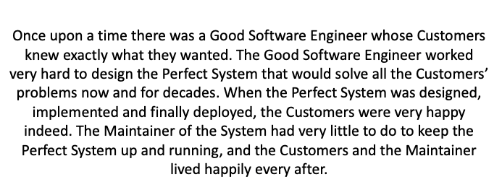
A Fairy Tale
Notes:
Let’s start with a fairy tale…

Slide 31
Why Isn’t the Fairy Tale True?
The Law of Continuing Change
A program used in a real-world environment must change, or become progressively less useful in that environment.
The Law of Increasing Complexity
As a program evolves, it becomes more complex.
Resources are needed to preserve and simplify structure
Notes:
We are kidding ourselves if we think that we can know all requirements and build the perfect system. Software is not a static artifact, not a bridge that we build in place and forget about it until we need to make repairs. The best we can hope for is to build a useful system that will survive long enough for it to be asked to do something new, then try to manage that evolution. In particular, there are two laws of software evolution that come into play and increase development complexity (go over)

Slide 32
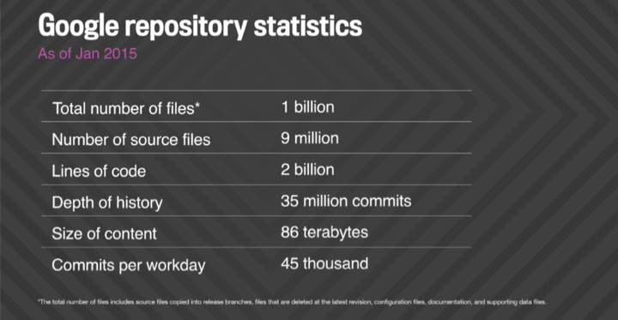
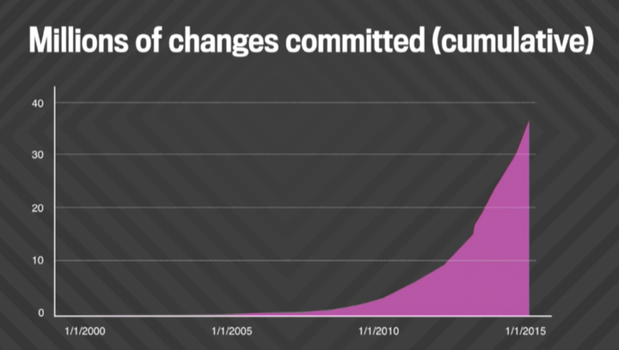
Development at Google
Notes:
To see what this looks like in action, we can take a close look at Google (old stats from 2015, but the same trends surely continue, if not being more accelerated. )go over stats - the thing to look at is this graph of commits. Look at that curve. That is basically an exponential curve. As the system evolves, the complexity of the code - not just its functionality, but the work required to keep it all working, keep it understandable, keep everything from falling apart - increases exponentially.

Slide 33
Development at Google
>30,000 developers in 40+ offices
13,000+ projects under active development
Single code tree with mixed language code
All builds from source
30k commits per day (1 every 3 seconds)
30+ sustained code changes per minute with 90+ peaks
50% of code changes monthly
Requires execution of 150+ million test cases / day

Slide 34
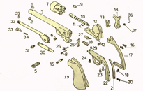
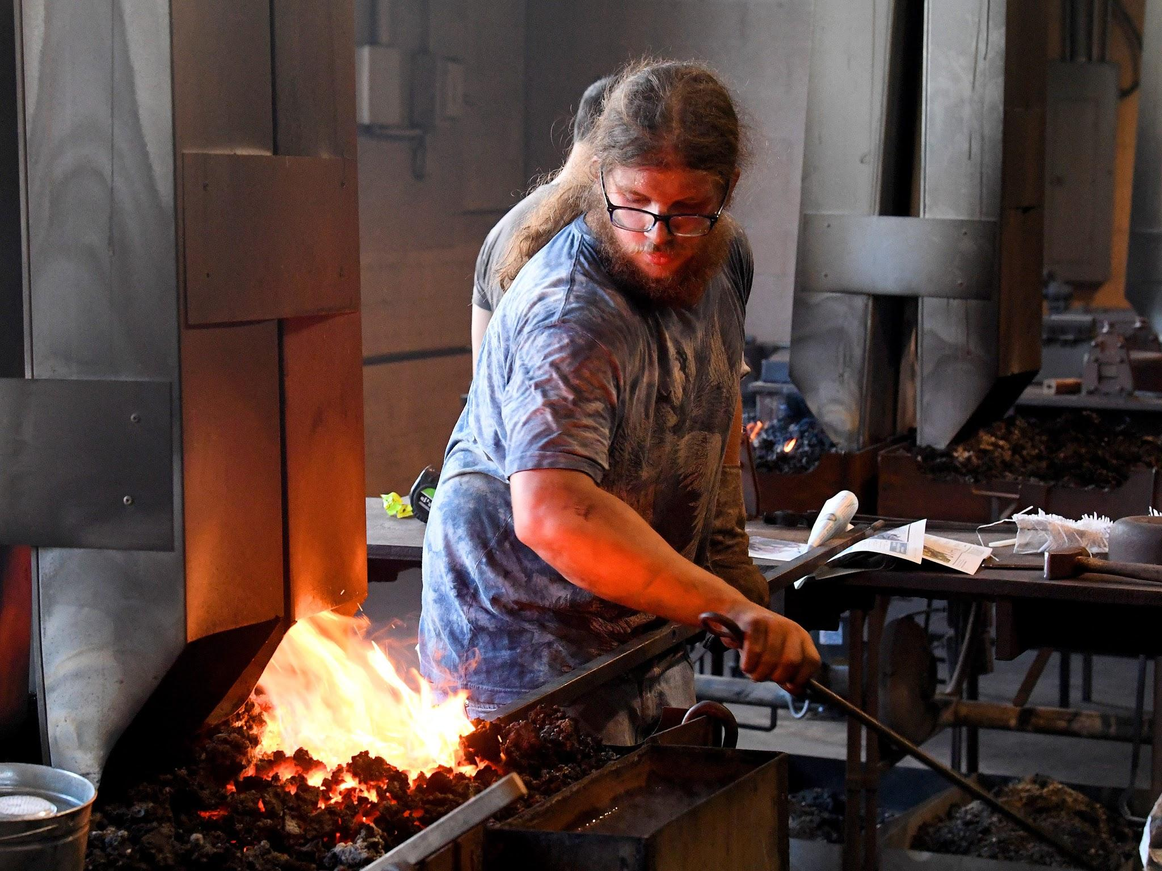
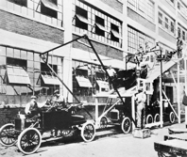
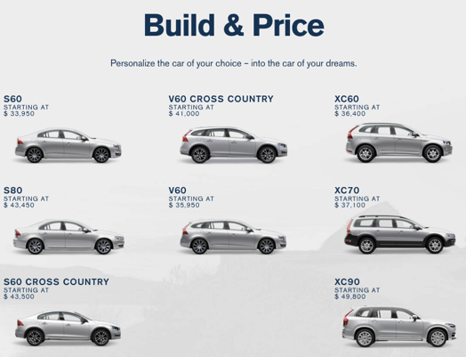
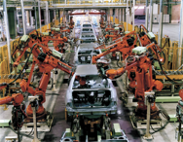
Customization
Replaceable Parts
Hand-Crafting
Assembly Line
Product Lines
Automated Assembly Line
Customization
Standardization
Notes:
To look at a major contributor to complexity, we need to step back in time a bit. Before the industrial revolution, the manufacturing process was handcrafting— everything was designed for the individual. No two goods were produced exactly the same. Handcrafting makes it easy to incorporate individual requirements and to build a product specifically for the customer’s needs. After industrialization, mass production changed this picture. Mass production based on assembly lines required standardized parts that are combined to create products. Mass production greatly improved productivity: standardized products reduced production costs and improved quality. However, individualism was lost. One product for all. The early Ford Model T car could only be bought in black. Clothing came in a set of sizes instead of being tailored to the perosn buying it. In all cases, prices drop, quality rises, but at the cost of having only few standardized products. Recognizing that different customers have different needs, manufacturers started to increase diversity in their products. car manufacturers offer different variations of a car at different prices. Manufacturers still use reusable parts, but combine them in different ways, prepare specific alternatives for individual parts, or add extra parts. This creates the idea of a product line: A product line is a set of products in a product portfolio of a manufacturer that share substantial similarities and that are, ideally, created from a shared set of reusable parts. Instead of offering a single, standardized product, manufacturers now aim at diversification, this way, being able to offer multiple products tailored to individual market segments, including products for niche markets.

Slide 35
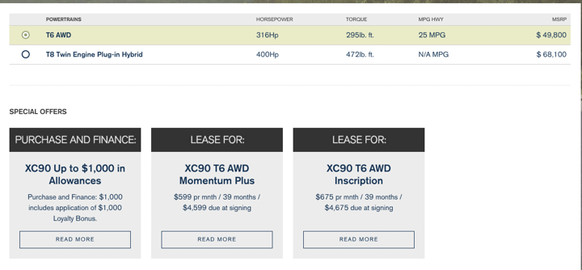
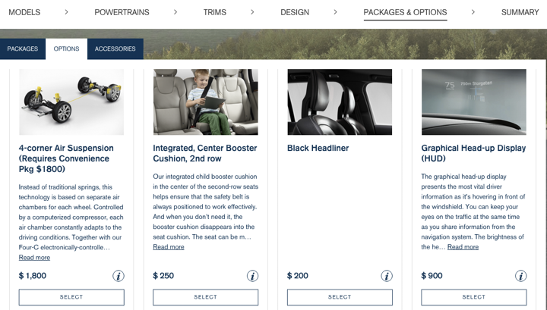
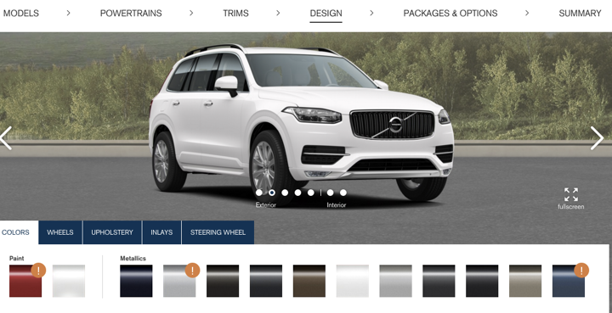
Mass Customization
Volvo XC90
Choose your engine...
Select bonus features.
Choose your color.
Notes:
In many domains, mass customization has marked a return to individualism in production. Nowadays, manufacturers of cars, computers, and many other products allow their customers to configure products to their needs before production. The production process still has mass-production characteristics: The products are constructed at large scale, often in an automated fashion, based on standardized, reusable parts. The goal is to share as many parts as possible between all products; however, manufacturers support variations within their production process, and they allow customers to select from alternatives, for example, different engines, colors, interior features, electronics, and so forth in the automobile industry. Customers tailor their product by choosing among a predefined set of configuration options. Often, the configuration space is incredibly huge. Consider the Volvo XC90. If you order one today, you don’t just walk in and say you want the XC90, you need to choose your configuration. almost every car that leaves a modern automobile factory is unique—each tailored to the needs and wishes of a particular customer - so you select your engine - combustion or hybrid - your color - gray, white, blue - do your seats have leather or cloth covering. There are many optional add-ons - do you want a booster cushion for a child? want a graphical heads-up display? you can get these added for an additional cost.

Slide 36
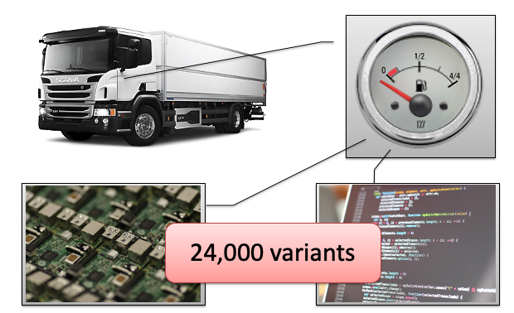
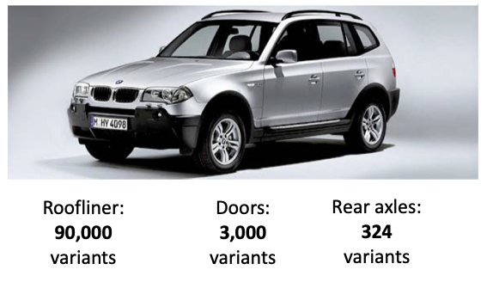
BMW X3, Scania Fuel Indicator
Notes:
Those are only a small excerpt of the choices a customer can make. Actually, there are hundreds and thousands of possible choices. This rich set of configuration options gives rise to an astronomical number of possible car variations. The website you walk through guide you through a configuration, providing feedback, hide invalid choices, and so forth. It offers choices in terms of check and radio boxes; there are even sliders to choose within a spectrum of possible values. Under the hood, these choices lead to more variants than you can possibly imagine. The BMW X3, for example , (go over slide) - coming from different selections of parts, colors, hardware features. Consider a simple fuel-level indication system in a Scania truck. You would think this would be simple - just show me how much fuel I have, but it encompasses around 24,000 different variants arising from the combination of different software features and hardware parts. Some variants are directly related to individual mechatronics components (for example, transmission type), others emerge from the interplay of multiple parts (for example, fuel efficiency is a byproduct of several hardware and software components working together).

Slide 37
Number of Variants Explodes
30 years ago: Mass Production
Few extras (alternative cassette player or roof rack)
Single variant (Audi 80, 1.3l, 55hp) 40% of all sales
Now: Mass Customization
10²⁰ configurations at Audi, 10³² configurations at BMW
100 different undercarriages, 50 steering wheels
Identical configurations are rarely produced
This is OK because of shared assets.
Notes:
What are the numbers we are looking at? (1) Only a few variants - select a model and a few extras (2), and (3) (4-7). This is OK because, once a configuration is set, the corresponding car is not designed and built from scratch. Rather it is constructed automatically from reusable parts that are related to the choices made by the customer

Slide 38
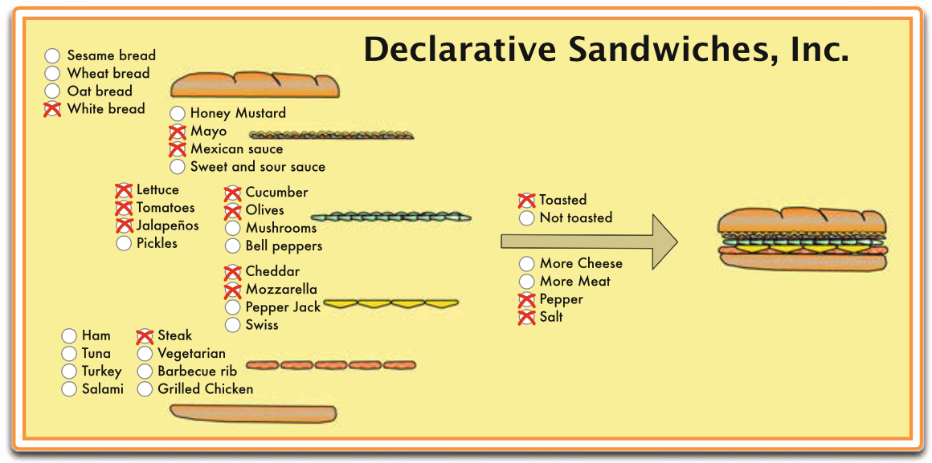
The Sandwich Shop
Sandwiches are build to match customer requests.
Not arbitrary. Customer chooses from a set of successive choices.
Meats, toppings, sauces.
Shared assets.
Notes:
This kind of scenario is hardly restricted to cars. Mass customization is part of everyday life. When you order a sandwich at Subway or whatever, you see a product line approach at work.These sandwich shops allow their customers to choose among a set of options to create their own favorite sandwich. The space of possible choices is large, including different kinds of bread, main and side toppings, as well as various sauces and spices, but finite. The shop does not take arbitrary requests and shop and prepare ingredients for each order; instead they prepare parts, such as sliced tomatoes, precooked meats, and sauces, that can be combined. Shared assets again. The space of possible sandwiches is huge, possibly offering a suitable and tailored choice to the vast majority of customers. But, it is still cheap, hiugh quality, and efficient because we use shared assets.

Slide 39
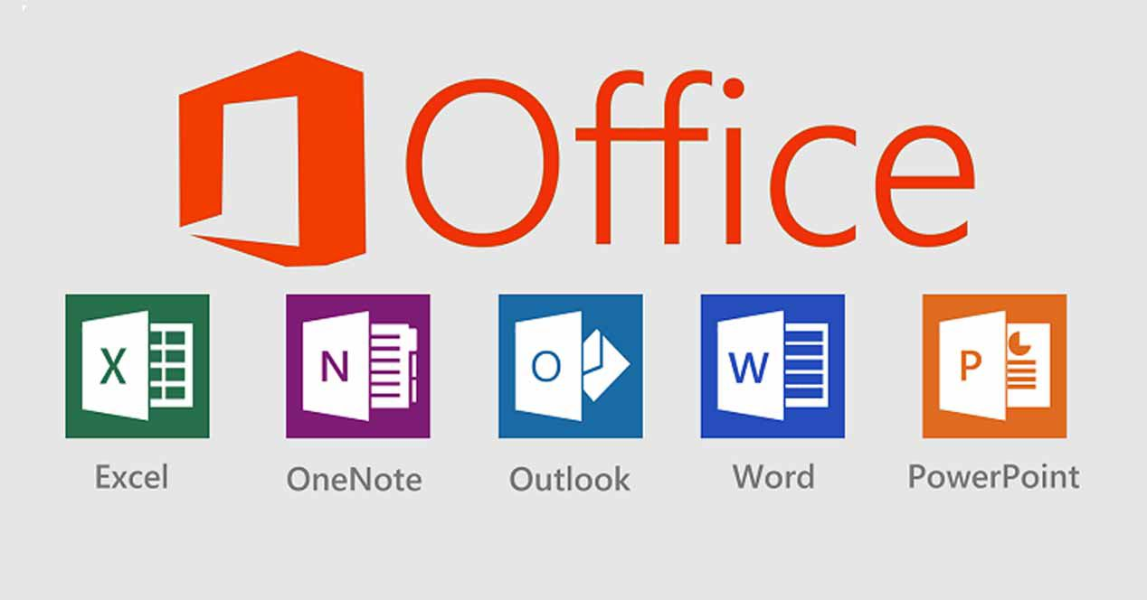
Standardized Software
Industry agreed on standard platforms
Ex: Excel instead of your own spreadsheet program.
Tries to satisfy the needs of most customers.
For most customers, many features are not needed.
Can lead to software that is hard to use, slow, buggy.
May still be missing features, not support hardware, ...
Notes:
In the same way, we have specialized and standardized software. Software development has seen a history not quite unlike that of producing physical goods - and highly connected to that of physical goods. Early software products were handcrafted for specific hardware and sold, bundled with the hardware, in small numbers. However, software production became increasingly challenging and expensive with the demand for more and more complex software and more and more usage scenarios. Software producers attempted a strategy of standardization. Instead of redeveloping operating systems, compilers, and tools again and again, the industry agreed on standard platforms. This eventually enabled to production of software packages that were deployed on scale and could be installed on millions of Mac or Windows desktops, like Miucrosoft Office. However, much like mass production provides standardized goods at the cost of not supporting individualism and rare corner cases, standard off-the-shelf software tries to satisfy the needs of most customers, which leads almost automatically to the situation, in which customers miss desired functionality and are overwhelmed with functionality they do not need actually (just think of Excel again - how much functionality do you actually use from it?). It is often this generality that makes software complex, hard to use, slow, and buggy. While standardization empowered the software industry to substantially scale development and to provide affordable software to a broad market, it often does not address specialized needs of single customers or companies.

Slide 40
Customized Software
Personalization
individual requirements, look & feel, special algorithms
Hardware
robots (sensors and actuators), computers (hardware devices)
Resource restrictions
energy consumption, performance, memory demand
Software and product quality
usability
maintenance/verification/validation effort grows with functionality
Notes:
Especially, for resource-constrained or energy-constrained environments, such as mobile platforms, embedded systems, IoT devices, bloated one-size-fits- all solutions don’t work, which means that a lot of software is still written from scratch, even though it may be similar to existing products. For example, Oracle bought a new DB company to perform data management for embedded systems, instead of trying to make their own DB products work. Also, specific requirements and market segments are typically not well-addressed by off-the-shelf software. Custiomized solutions - customized variants of the same basic idea - functionality - are often needed (go over) sensors (cameras, lidars, radars), actuators (motors, robot arms)

Slide 41



Complexity Grows in Time and Space
space (variants)
branch
branch
time (revisions)
Notes:
A core challenge, however, when you when you start to customize software, is that the software now grows in complexity over both time and space. We start with our first, core version. And we evolve it over time, making commits to the version control system. Now, we start offer customized versions to our customers. If we’re volvo, we start adding variants to the truck model that require software support. One way to do this is what we call clone & own, and we’ll cover that in more detail soon. In clone & own, we take a snapshot from the master branch, split off, and start making our new changes - our customization (click) we do this, then a little later, we do it again. (click) Each of those start their own timeline, where they now evolve. You can start to see, then, why this can get complex quickly. (click) remember that graph, now we have that times three. (click) Now, we see that complexity does not just grow over time, but also in space - a multiplicative effect from each variant we introduce.

Slide 42
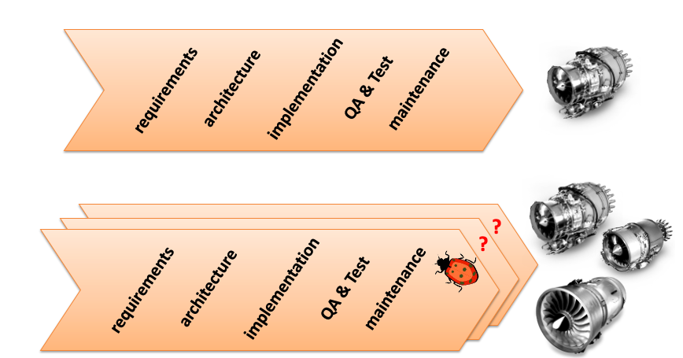
Variability Adds Complexity
Notes:
Variability adds essential complexity. Let’s say you have developed one successful turbofan engine. You get new customers: small airplanes, large airplanes; jet, prop, and helicopters---all have very similar basic turbine engine design; so you get variants: turbofan, turboshaft, turbo prop,. When you develop a set of products, you deal with variation in requirements, architecture, implementation, test, maintenance;
code that implements many variants is inherently more complex than code implementing a single product; same applies to other phases. Variability poses new questions: E.g., when a bug is discovered in one product, what other products are also affected? The complexity quickly grows.

Slide 43




Variability in Software Ecosystems
eCos Linux Kernal Eclipse Debian Android
What: embedded OS, OS kernal, IDE, desktop/server OS, mobile OS
Customization: config options, config options, add-ons, packages, apps (event handling)
Notes:
To give an example, we can look at five open-source software ecosystems. You think of these, generally, as individual systems. One unit, install, run, but they are all highly vairable and can be greatly customized to the point where they are unique to individual users, and your configuration -your custom version - is not the same as someone else’s. eCos is an OS for embedded systems, the Linux kermnal is a general-purpose set of core libraries needed for an OS, Eclipse is an integrated development environment for a number of programming languages, Debian is a complete OS - built on the linux kernal - for desktops and servers, and Android is - of course - the most popular mobile device OS. How can these be customized? eCos and the Linux kernal are customized by setting configuration options. Eclipse is customized through add-on bundles, these support new languages and new development features - adding testing and debugging, refactoring options, etc. Debian can be customized by the packages installed on it, changing core components of the OS - swapping elements of the underlying OS with other ,compatible options, which can add or replace functionality. Android can be customized by the apps you have installed. I don’t mean that you have more programs running, but you change the fundamental experience - the apps installed determine how events are handled - which app makes a phone call, which opens an e-mail, which reads downloaded files, apps change the UI actively, and create a customized experience for each user - built on the same rough core.

Slide 44





Variability in Software Ecosystems
eCos Linux Kernal Eclipse Debian Android
Options 2.8K 13K > 7K 28K > 3.3M
Notes:
Each of these has vast variability. Look at the number of variables, number of options we can choose from. This isn’t the number of variants, but the options to choose form. Just the sheer number of the variables is huge---in thousands. Look at Android. Then, the variants are the possible combinations of those options. The numbers are big --- into thousands --- there are clearly more potential instances of each of these systems than the atoms in the universe.(2^32 – is the number of atoms in the universe)

Slide 45
Controlling Variability
Variability mechanisms introduced controlled points where customization can occur.
called variation points
Variation points determine the concrete software variants that can occur.
In a closed system, we know how many variants are possible (Linux kernal)
In an open system, we cannot know all possible variants
(Android - ex: different apps can be bound to variation points)
Notes:
Each ecosystem uses different strategies and techniques to implement and control variability. A variability mechanism is an implementation technique to delay design decisions about functionalities and qualities of a software system so that we can control how it varies. To flexibly adapt software to user requirements at later stages—such as build-, startup- or run-time—variation points are introduced into a software platform, using an architecture that supports variability. Variability mechanisms are used to implement variation points, which are locations where variability can occurs. Variation points are bound with concrete variants, which are either known (closed platform) or unknown (open platform) during platform development. For instance, the Linux kernal is a closed platform in that there is a known set of configuration options and a known number of variants. It’s open source, more could change, but the code contains the possible option and we can inspect that and count them. On the other hand, in an open platform like Android, we cannot know all possible variants - anyone can add a new app. However, we still control variance through defining constraints on the variation points - for instance, we could use any number of apps to handle events like sharing a photo. Anyone can add more options. However, we have a defined variation point - that event - and that gives a way to control how even handling is performed and define constraints on the options used to handle these events.

Slide 46
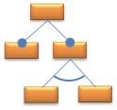
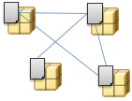
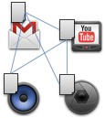
Variability Mechanisms
Linux and eCos use feature models
Hierarchical menus of config options
Centralized list of options, constraints limit combinations.
Debian and Eclipse use manifest-based packages.
Structured metadata about the options.
Version info, dependencies, categorization.
Central repositories
Android uses service-oriented apps.
Provide a common interface and constraints on capabilities
Hook to concrete apps at run-time.
Notes:
Each ecosystem uses different strategies and techniques. Linux and ecos use Features models – hierarchical menus of config options. Feature models abstractly describe and organize the variabilities at a central place, and are input to configurator tools, which help users resolving variabilities. Constraints restrict their valid combinations and values we can choose from, based on the decisions made higher in the hierarchy. Debian and Eclipse use Package-management systems with defined manifests. manifest files describe data about the options we choose. They allow variations to be added flexibly, but still enable centralized collection of options. Manifests adhere to a schema, which can be a grammar for textual manifests, or an XML Schema for XML-based manifests, and contain information like version info, dependencies, and categorization information. Android allows more freedom than any of these through Service-oriented apps – providing interfaces and a list of required capabilities; looked up and bound at runtime to compatible apps. We don’t care about the internals of the apps, what they are or how they work, but we define a common interface and requirements, and offer hooks for apps to attach to. At runtime, we call the interface, and it delegates to the correct app.

Slide 47
Variability Management
Friction between managing variability and encouraging it.
Management allows control of scope, limitation of number of variants.
However, encouragement unleashes innovation and encourages competition.
Many options we will cover in class will help manage and control variability.
Notes:
(1) Managing it allows control of scope of the system and limit to complexity, it allows you to eliminate variants if they are not needed, it gives essential control of development. However, encouragement is good as well. It unleashes community innovation, it enables far richer experiences and far more customization. The cost is that you let the community decide the scope now. Both sides have their merits. Control is good, but encouragement is also good - enabling competition. The open marketplace is what makes Android so powerful. (last point).

Slide 48
Software Product Lines
Notes:
Just start with a question - want you to start thinking about this. (read)
This isn’t something with one answer, or even a right answer. It’s something we’ll keep returning to

Slide 49
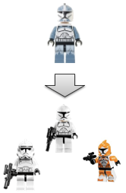
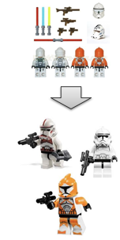
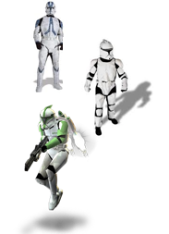
Software Customization
Build Independently
Clone & Own
Shared Assets
Notes:
Lets say we want to customize our software. How do we do this. Essentially, there are three options: build each version completely indpedently. Start from scratch, or selectively reuse code, and develop independently. That can be good, but is obviously very expensive and requires great effort. Second, is clone & own, which we mentioned a little already - take the existing code, split off a new branch, and start making your own changes. The third, which is the basis of software product lines, is to use shared assets - a core code base, and use variation points to choose from those assets and bring them into play.

Slide 50
Software Product Lines
Build variants from reusable shared assets.
Customers select from configuration options.
Assets = code components, interfaces, other resources.
Enables customization, while retaining benefits of mass production.
Avoids explosion in “space” as we manage the portfolio of assets instead of each individual variant.
Notes:
The central idea of software product lines is that instead of developing software systems from scratch, they should be constructed from reusable parts. Instead of composing a software system always in the same way, it should be tailored to requirements of the customer, where customers can select from a large space of configuration options. The software product line approach provides a form of mass customization by constructing individual solutions based on a portfolio of reusable software components - those shared assets I keep mentioning - where an asset can be code components, APIs, UI elements, images, and other resources. It introduces individualism into software production, but still retains the benefits of mass production in that huge domain and market segments can be served. It also avoids the exponential explosion in time and space, as we don’t manage entire clones, but rather the one portfolio of assets and variation points.

Slide 51
Feature-Oriented Approach
Features distinguish products from a product line.
Editor Version A has spell-check. Version B does not.
E-mail client A supports IMAP and POP3. Client B supports only POP3.
Product line artifacts and process structured around features and feature interactions.
Discuss control, implementation, verification of features.
Connects requirements to customizations in code.
Notes:
Ideally, based on a set of reusable parts, a software manufacturer can generate a software product based on the requirements of a certain customer. The concept of a feature is central to achieve this level of automation. Features are used to distinguish the products of a product line, for example: one text editor provides a spell-checking feature, while another version does not. Database system variant A provides multi-user support, variant B does not. E-mail client A supports IMAP and POP3, client B supports only POP3.” and so on. As a result, we tendto organize and structure the whole product-line process as well as all software artifacts involved in terms of features, and reason abotu variability by discussing how we control, implement, and verify the interactions between features. This way, it is easy to trace the requirements of a customer to the software artifacts that provide the corresponding functionality. We features explicit in requirements, design, code, testing, and so forth—across the entire life cycle.

Slide 52

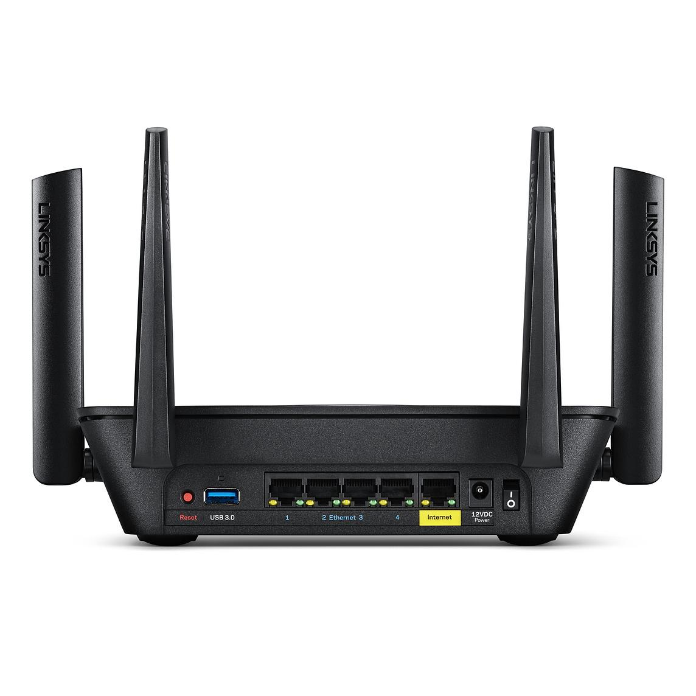
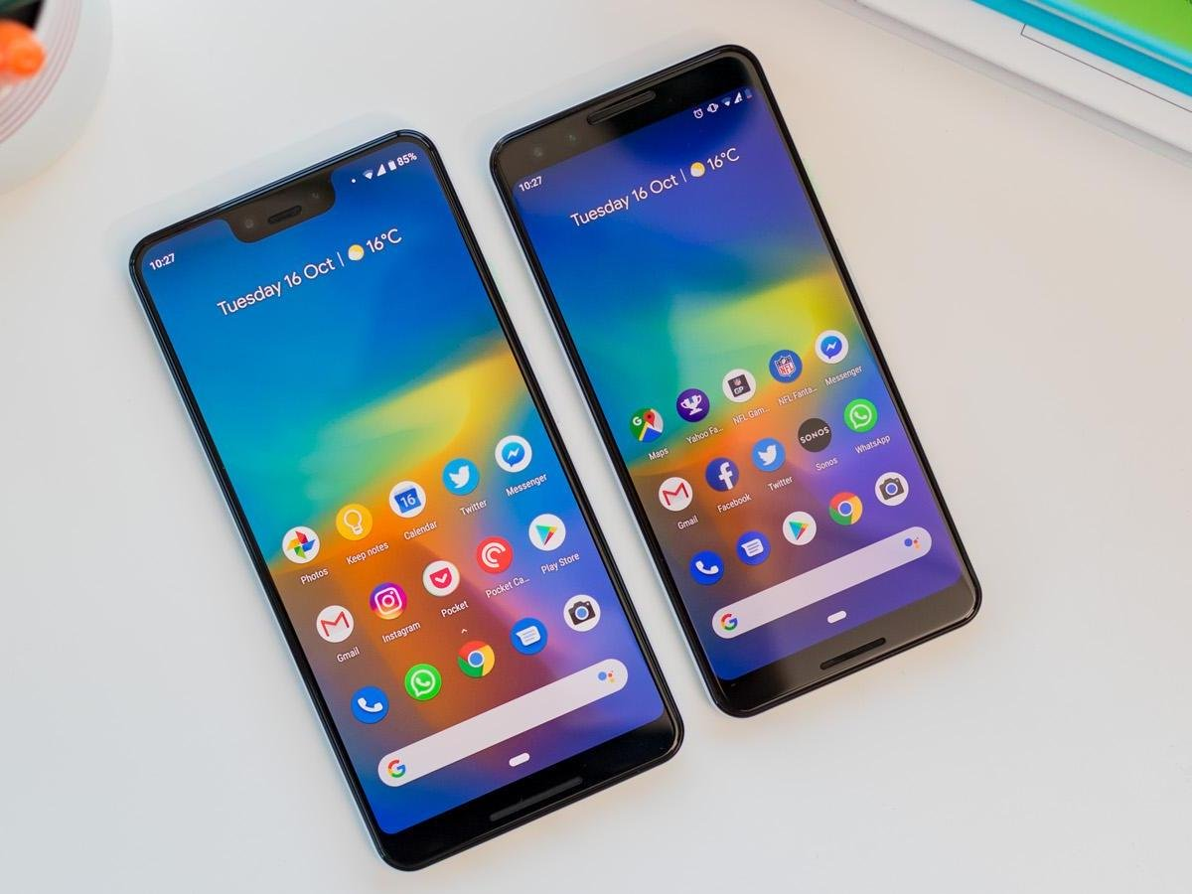


Example: Linux Kernel
> 8M Lines of Code
Supports > 22 hardware architectures
> 13,000 configuration options
Notes:
An example of a SPL you interact with daily is an operating system. Almost every computing system today contains an operating system, which mediate between hardware and application software. Modern operating systems have to run on different hardware platforms and serve the needs of various applications. For example, the Linux kernel runs on a wide variety of different platforms, including embedded and mobile devices - it is the code of Android even-, desktop systems, and large- scale servers, supporting a huge portfolio of different applications scenarios, from sense-and-control applications,to office software and games, to high-performance computing and server software. To do this, the Linux kernal must be highly customizable. - and it is! Clearly, there cannot be a single operating system that efficiently supports all kinds of different platforms and application scenarios. Instead, modern operating systems are configurable. The linux kernal has over >8M lines of code, supports >22 hardware architectures (e.g., ARM, x86, powerpc), >13,000 configuration options (features). Most source code is optional. What you get, what is running and available, depends on the choices you make when you select those configuration options.

Slide 53
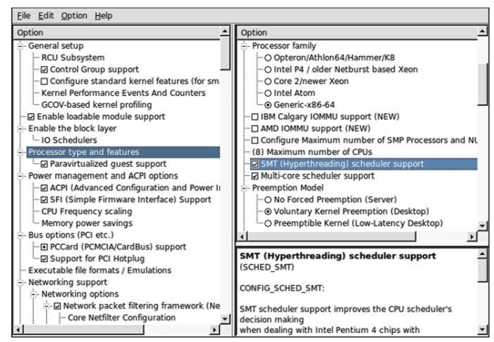
Ex: Linux Configuration Tools
Kconfig used to tailor Linux kernal for custom use.
Compiles a custom Linux kernal with only the selected options.
Omits unnecessary or incompatible features.
Notes:
here we show a screenshot of Linux’s configuration tools, called Kconfig, that can be used to tailor the Linux kernal for specialized use. Kconfig helps make the Linux kernel highly modular and customizable. You don’t need to be an exper in this tool, but it shows here the kind of customization we’re talking about. You can select which features you need for your installation, which processor familiy is to be supported, and which haerdware features are required. Under the hood, then, this allows you to compile a custom version of the Linux kernal, omitting the souece code you don’t need -leaving out unnecessary features - which would only lead to potential bugs and slowdown - and incompatibilities that could occur based on the options you chose.

Slide 54
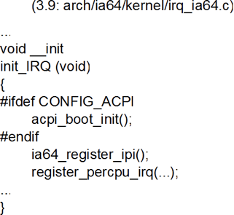
Configuration Options
Linux kernal customization managed through a feature model.
Configuration options are features.
Constraints are used to prevent illegal combinations.
Conditional compilation.
If we select this option, the contained code will be compiled into the custom build. If not, it is omitted entirely.
Unique build tailored to choices.
Notes:
In Linux, customization is controlled through a model we mentioned earlier, a feature model. A feature model imposes a hierarchy over customization, imposing constraints on the combinations of choices we are allowed to make. The configuration options are the features of this model. Defined constraints then are used to prevent illegal combinations of features. First, we can see how this is defined in the code. CONFIG_ACPI is an option we can enable. ACPI allows the operating system to control power management, as opposed to controlling it at the bios level. In the code, then, we can check whether that option is enabled (IFDEF). If so, then we call this method, then continue execution. If not, we skip this step when running the code. #IFDEF is a C/C++ directive. It checks whether a macro has been defined. It is a little different from an if statement, rather, it enables conditional compilation. If this option is set, the code is compiled with that line in place. If not, that line is completely omitted from the compiled executable. This is a cornerstone of product lines, we select options and get a unique build tailored specifically to those options.

Slide 55
Benefits of Product Lines
Products tailored to specific customers.
Reduced costs, fast start-up, reduced complexity through asset reuse.
Slower initial effort, but it pays off quickly.
Improved quality from testing assets in isolation.
Frequently used assets will be heavily tested over time.
Can quickly produce new variants or change variants to respond to market conditions.
Notes:
When choosing between developing individual software products from scratch and developing standardized one-size-fits-all products, software product lines offer benefits: Tailor-made. A product-line approach facilitates tailoring products to individual customers. Instead of providing a standardized product (or a small set of preconfigured products),you can produce a whole set of differently tailored products. Reduced costs. While providing each customer its desired solution, you do not need to pay the cost of designing and developing each product. Instead, they develop reusable parts that can be combined in different ways. The development cost per product per customer can be reduced to selecting which parts to combine (potentially add missing ones) and to testing the resulting product. You get fast startup when creating a new variant, as you already can make use of the exisitng code base to provide much of the solution without significant change, and as I mentioned, reduced complexity, as you don’t need to manage many full products, but just the library of assets and skeleton code. While the upfront investment is certainly larger than developing a single software product (we need to design reusable parts and implement variations that might not be required for the first product), the approach pays off in the long term, when multiple tailored products are requested. Improved quality. mass production has improved quality because stan- dardized parts can be checked systematically and tested in many products. Standard- ized software offer similar benefits, compared to software developed individually from scratch. Software product lines offer a compromise, in that different product are constructed from standardized parts. Though not every combination is used by millions of customers, parts can be checked in isolation to some degree, and parts are reused and tested in multiple products. parts that are used frequently lead to more stable, lean, and reliable code. Time to market. While standard software is readily available, handcrafted software products require significant costs and time, before they can be released. If a customer selects only from predefined configuration options (that map to existing parts), you can quickly produce the requested software by assembling the existing, corresponding parts. Even if a customer requests functionality that has not been prepared, building a new product on top of existing well-designed, reusable parts is much faster than developing it entirely from scratch. A well-designed platform that can be extended for new products promises the possibility to quickly react to market changes, more so than standardized software or individual development could.

Slide 56
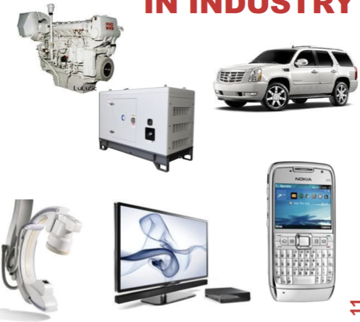
Success Stories
Boeing
Bosch Group
Cummins, Inc.
Ericsson
General Dynamics
General Motors
Hewlett Packard
Lockheed Martin
Lucent
NASA
Nokia
Philips
Siemens
Volvo
… (more success stories at https://splc.net/fame.html)
Notes:
Product Lines have grown more and more common in modern systems, and many modern systems use similar approaches to manage configuration, complexity, and variability. These approaches have led to success. We’ll look at more case examples this study period. I mentioned a couple earlier, like Cummins, Linux, Android, Eclipse, and so on. Many companies employ product lines. Some well known examples include (go over list)

Slide 57
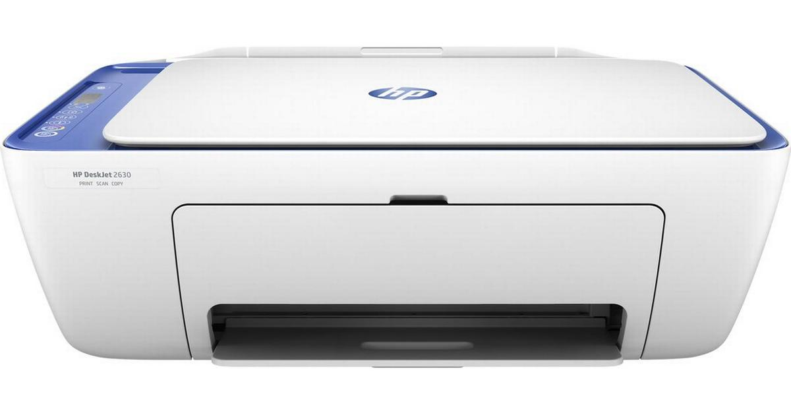
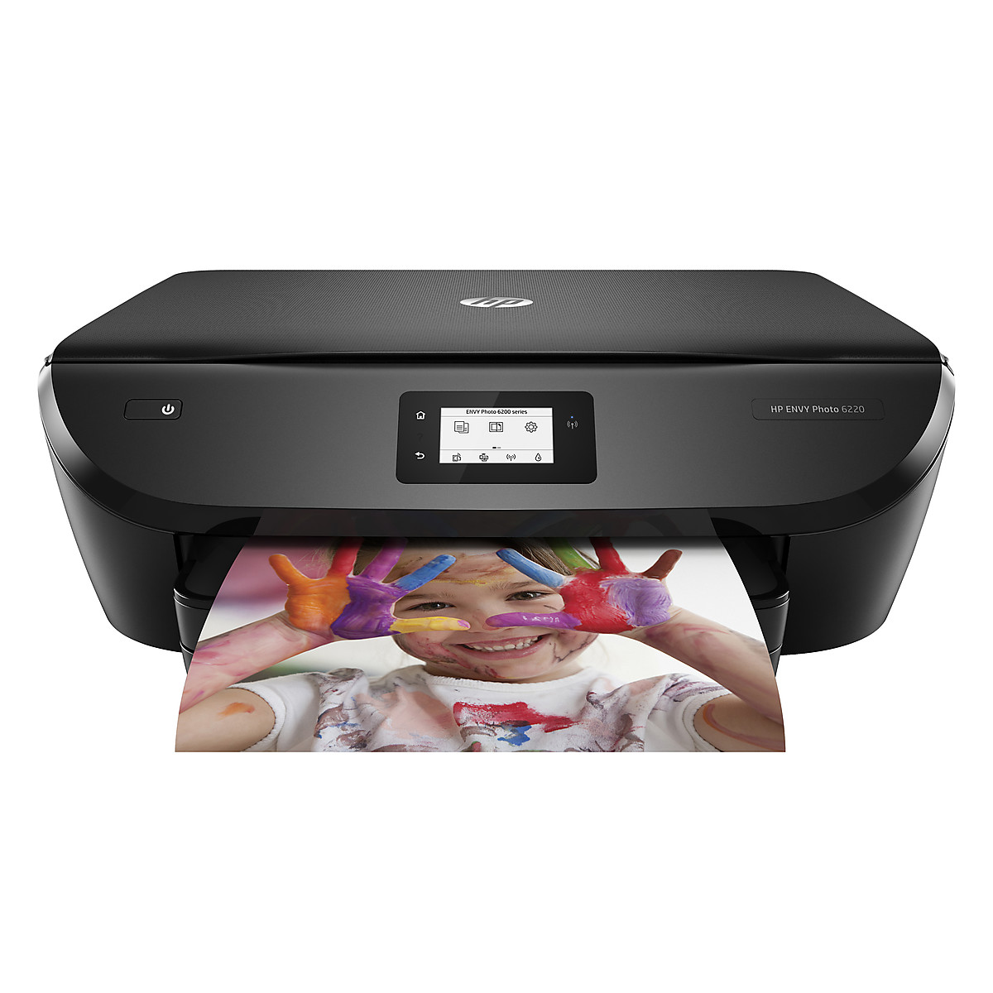
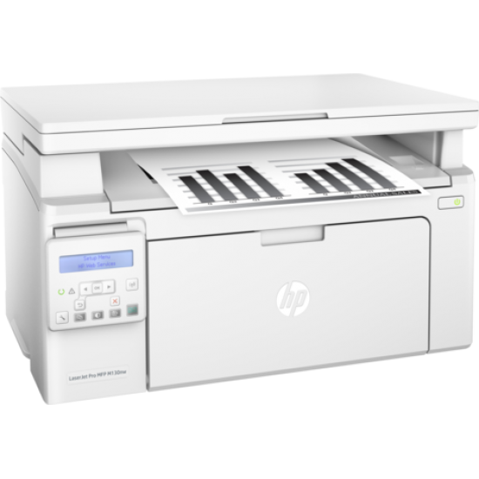
Hewlett Packard Printer Firmware
> 2000 features
Hundreds of printer models.
Production costs reduced by 75%.
Development time reduced by 33%.
Reported defects reduced by 96%.
Notes:
A little more concretely, we can look at Hewlett Packard , which pursues a product-line approach to develop printer firmware. It consists of over 2000 features supporting hundreds of print- ers. Moving to a product-line approach, products could be produced using 1/4 of the staff, in 1/3 of the time, and with 1/25 the number of bugs of earlier products.

Slide 58
We Have Learned
Modern software is complex!
Variability: The ability to change and customize software to deliver variants to new users.
Changeability and Maintainability: The ability to add new features while ensuring that existing code still works.
Software must evolve to remain useful.
Evolution introduces additional complexity.
Software Product Lines are designed to enable and take advantage of reuse.
Notes:
(read)

Slide 59
Next Time
Introduction to Domain Engineering and Modelling
Plan your team selection.
The earlier, the better!
Due Thursday, November 3, 11:59 PM.
SIX people, e-mail names to ggay@chalmers.se
Submit group number or desire to be assigned to a team on Canvas.

